Slide 1

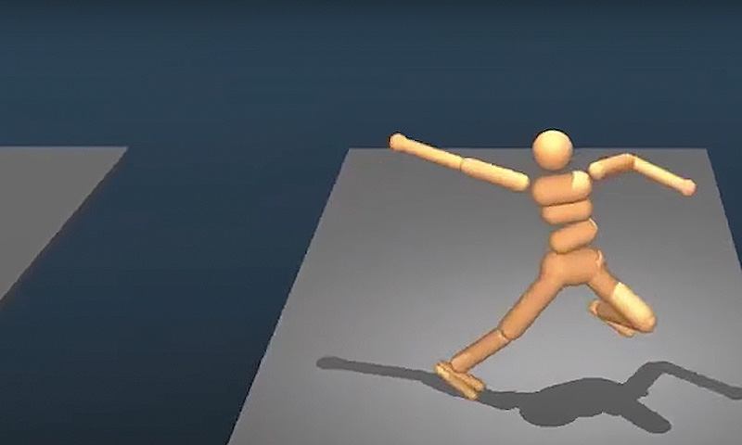
“The Application of AI for the
Non Player Character in Computer Games”
Group Members
1.Redoun Islam (160201)
2.Sheikh Sohel Moon(160202)
GOOLGE’s DeepMind AI just Taught itself to walk

Slide 2
Overview
Introduction about AI and NPC’S.
About our survey
Most Revolutionary methods used for non player characters(NPC) in computer games and take a look at some Game AI competition
future research areas
Conclusion

Slide 3
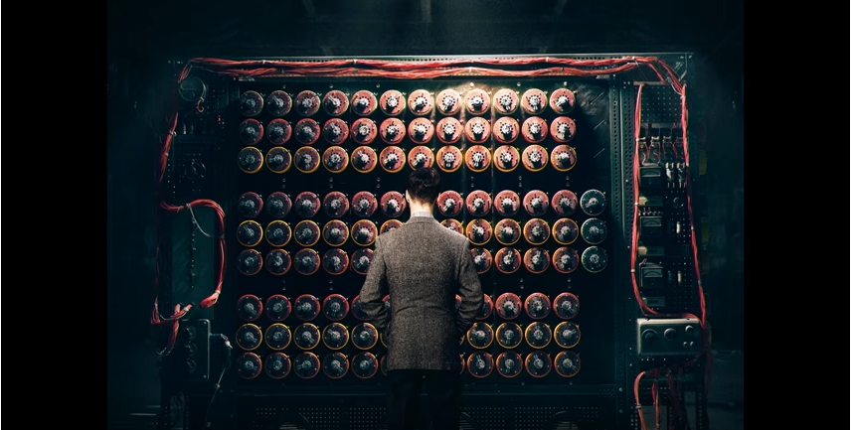

Slide 4
“I propose to Consider the question,
‘Can machines think?’”
-Alan Turing

Slide 5
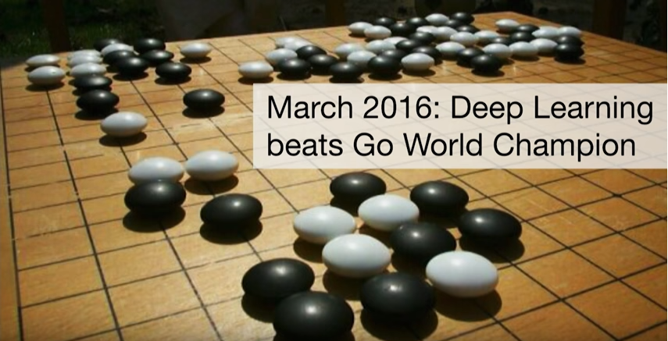

Slide 6
What Does it mean Something to be Artificially Intelligent?

Slide 7
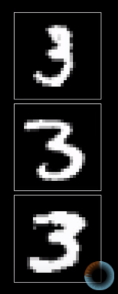
3

Slide 8
So What is Artificial Intelligence?
John McCarthy, widely recognized as the father of Artificial Intelligence define as “the science and engineering of making intelligent machines”
Software that can make intelligent decision based upon what it knows

Slide 9
So how does AI works within games?
Many video games adopt some form of AI as part of gameplay
NPC
Procedural content generator
AI researchers experiment with video games with a number of reasons
To improve existing techniques
To create new types of AI within the confines of game

Slide 10
what is a game to human?

Slide 11
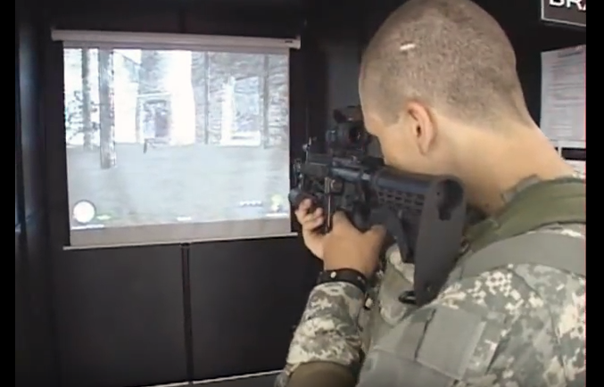
Values of Game
Games are stimulation for brains
Or rather, games are the food for the brain
Games are a challenge for people so it’s a good task for AI
We use games as benchmarks to test our new ideas
Video Games often provide interesting simulated worlds that replicate real world phenomena
Strategic combat
Airplane control
Car racing
Allows us to test algorithm and deploy in real world problems

Slide 12
What is an NPC
Non player Character
NPC behavior in computer games is usually scripted and automatic, triggered by certain actions or dialogue with the player characters
Bad AI of the NPC's often lead to shallow and unfulfilling game experience.

Slide 13
NPC classes
The behavior of AI has two classes
Reactionary
spontaneous.

Slide 14
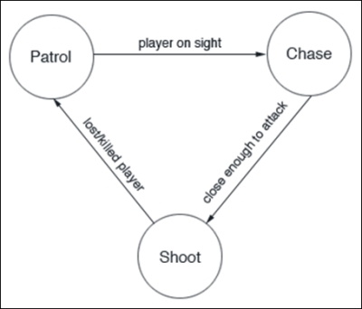
Reactionary
The reactionary AI is excited by the behavior of player.
The reactionary input also based on the feeling of NPC.

Slide 15
About our survey (2005 – 2017)

Slide 16
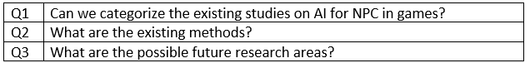

Slide 17
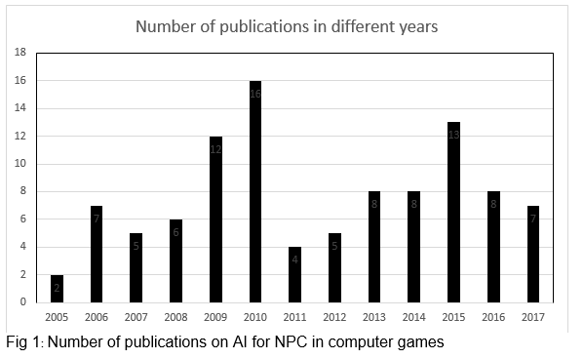
Statistics
We have found 97 research papers published on ieeexplore.ieee.org
In those papers we found 26 AI methods for NPC in computer games

Slide 18
Most Revolutionary methods used for non player characters(NPC) in computer games .
Fuzzy State Machine
Monte Carlo Tree Search
A Star Path Finding Algorithm
Reinforcement Learning
Neural Networks and Genetic Algorithm

Slide 19
What is a state machine ?

Slide 20
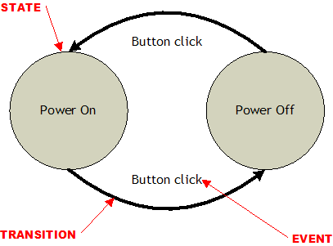

Slide 21
State Machines
A state machine has some number of states, and transitions between those states
Transitions occur because of inputs

Slide 22
Finite State Machines
A finite-state machine, or FSM for short, is a model of computation based on a hypothetical machine made of one or more states. Only a single state can be active at the same time, so the machine must transition from one state to another in order to perform different actions.

Slide 23
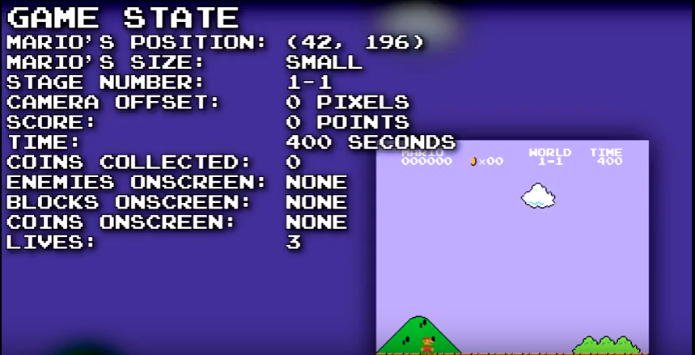

Slide 24
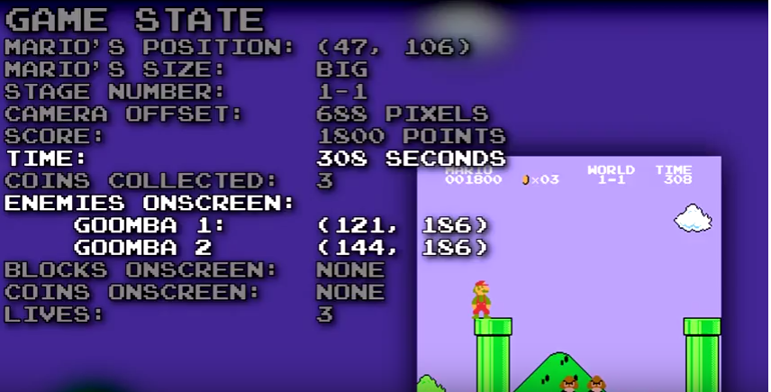

Slide 25
Fuzzy State Machine
Fuzzy logic is the extension of Boolean logic.
There are only “true” and “false” two states in Boolean logic, but there are some states such as “some are true”, “not far”, “not very friendly” in Fuzzy logic

Slide 26
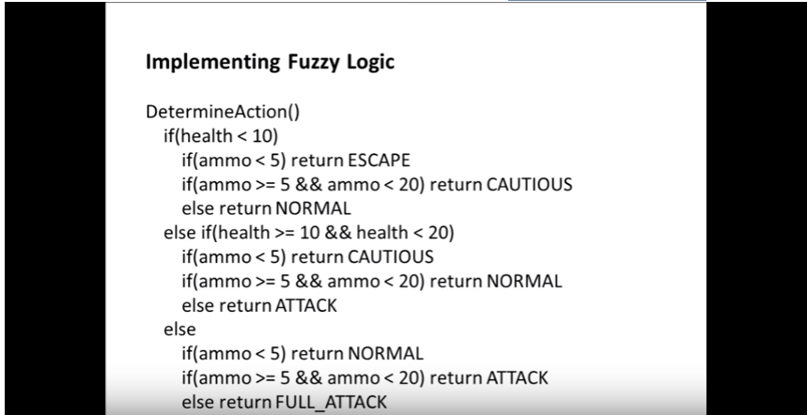

Slide 27
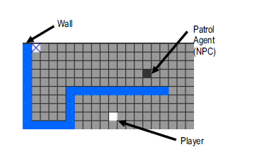

Slide 28
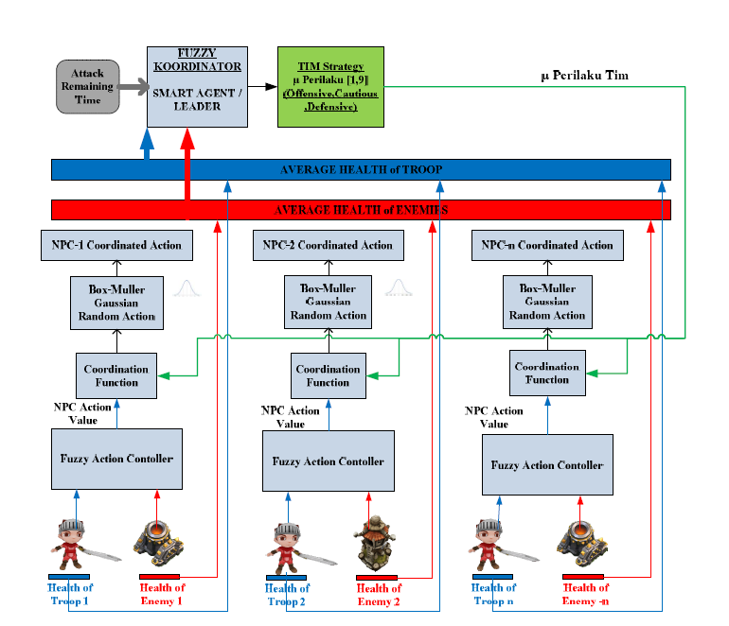

Slide 29
Monte Carlo Tree Search
(MCTS)

Slide 30
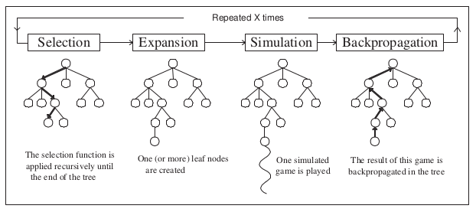

Slide 31
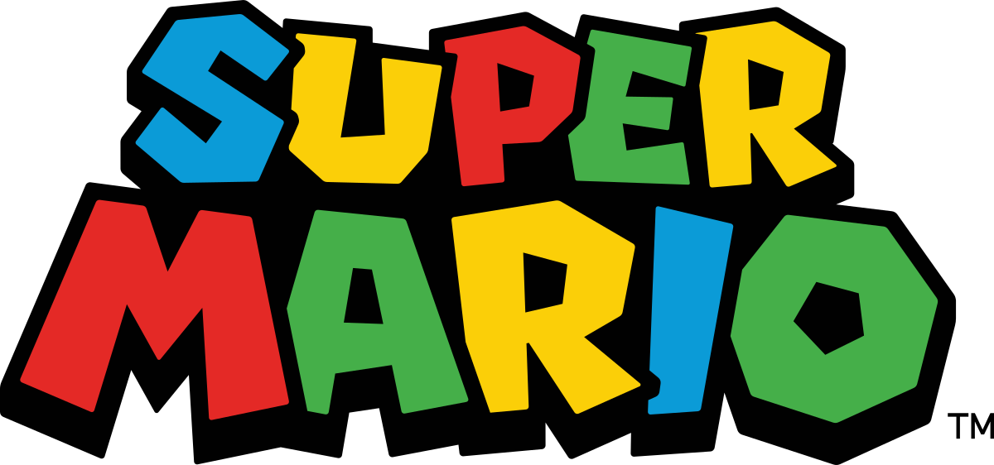
Best selling video game franchises of all time: 262 million sales

Slide 32
Super Mario Bros.
Mario came on the scene in 2009 , with the idea of evolving a player that can play Mario
Julian Togelius, Sergey Karakovskiy, Jan Koutnik and Jurgen Schmidhuber(2009) : “Super Mario Evulation”. Proceedings on IEEE Symposium on CIG
The next step was getting other researchers to play Mario Game
Can’t access the original source code

Slide 33
The Mario AI competition
Held between 2009 – 2012 , researchers were invited to write their own Mario Ai
The first track was gameplay , where people can create their own Mario
It didn’t take long to see some results

Slide 34
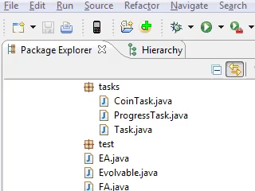

Slide 35
Pathfinding Algorithm
Pathfinding strategies are usually employed as the core of any AI movement system to find the shortest path
Types
A* Pathfinding Algorithm

Slide 36
A* is regarded as the best
Goal: compute a path from a start point S to a goal point G
Cost at point n:
f(n) = g(n) + h(n)
g(n): distance from the start point to point n
h(n): estimated distance from point n to the goal point
f(n): current estimated cost for point n

Slide 37
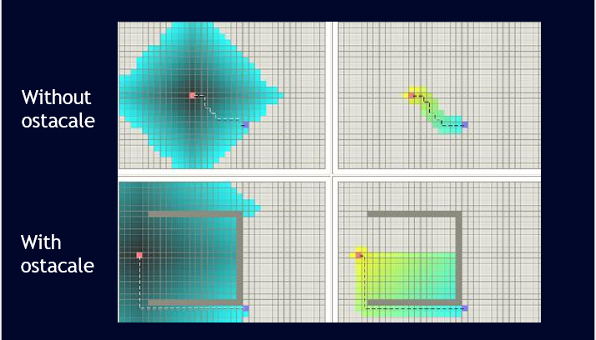

Slide 38
Mario Ai competition
The submission by Robin Baumgarten won the competition
Next phase of the competition is procedural content generator or PCG system where the Ai can create its own Mario level

Slide 39
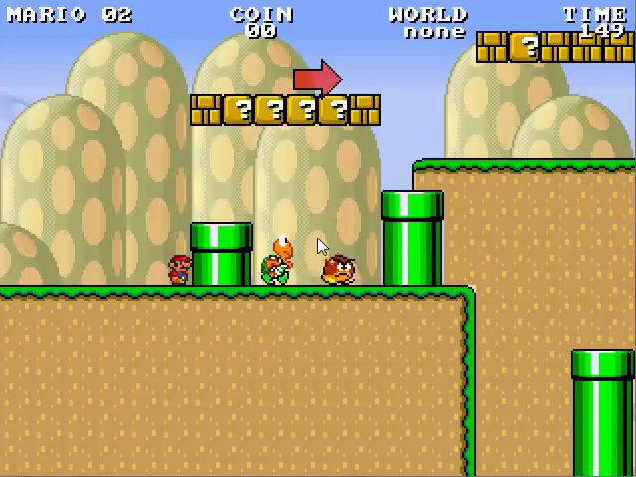

Slide 40


Slide 41
Genetic Algorithm and Neural Network

Slide 42


Slide 43
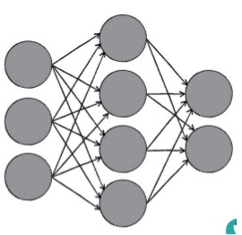
What Does a Neural Network Looks Like ?
In general it consists of
Input layer, where information is fed in
Hidden layer(s), where units dynamically process the information
Output layer , where prediction or conclusion is returned

Slide 44
Genetic Algorithm
Advantages
Powerful optimization technique
Can learn novel solution
No examples required to learn
Disadvantages
Finding correct representation can be tricky
Fitness function must be carefully chosen
Solutions may or may not be understandable

Slide 45
Future Works
HA* is better and more efficient then A* pathfinding algorithm but no research had been done on implementing HA* algorithm in computer games to benefit the NPCs. This demands a future research on this topic.
VR- and AR-based open-world video games may provide players with a “real world” experience

Slide 46
THANK YOU

